Slide 1
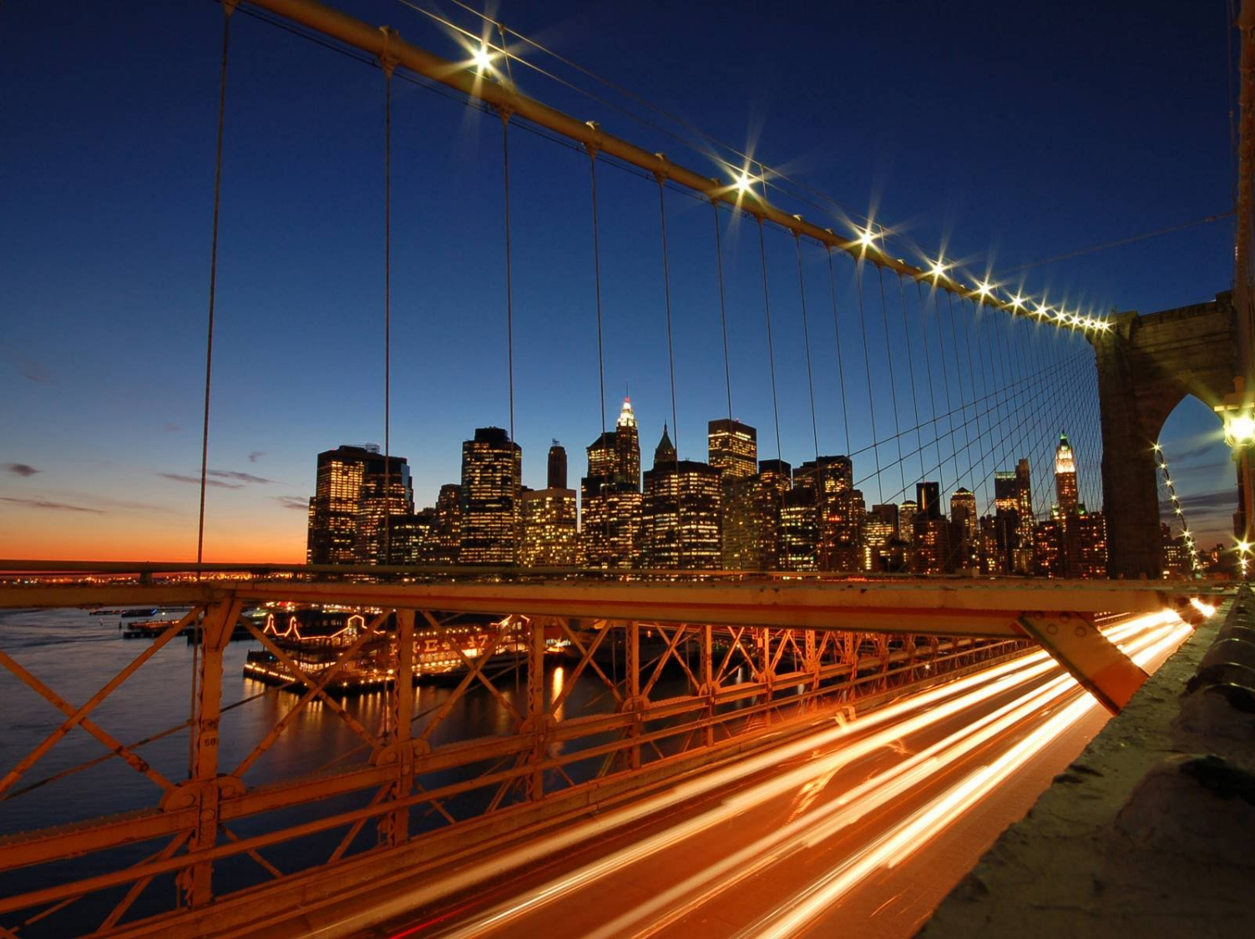

BES165: Infrastructure
Nuke Energy NSG, HELP-2016
Postal, Telecom, Mass.Comm (YB)
Kelkar-PPP
Rail Budget CAP-2016
Urban Infra-Bills.
Paris Summit Clean Energy

Slide 2
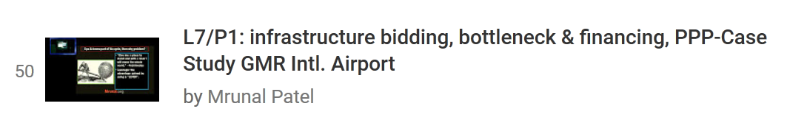
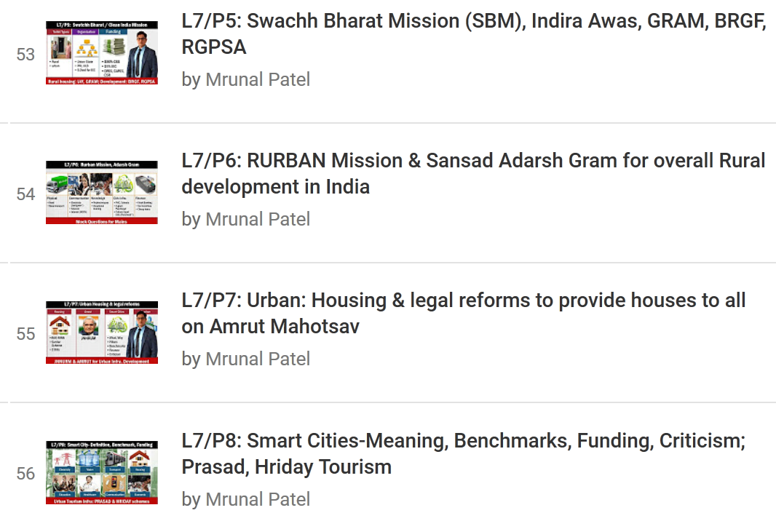

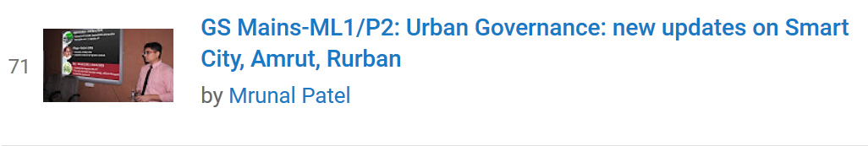
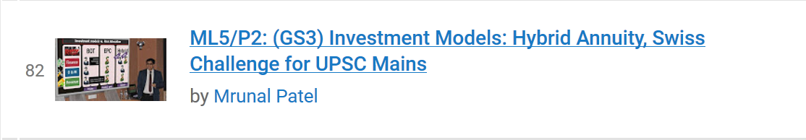

Slide 3
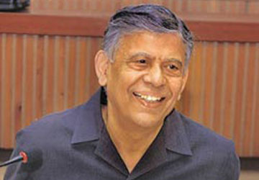
Vijay KELKAR: PPP revisit and revitalize
Because Jaitley announced setting up Committee in Budget 2015
Economist Kelkar- fiscal consolidation, oil sector reforms.

Slide 4
Kelkar
What is not PPP?
joint ventures between the government and the private sector mfg/oil exploration
Public investment in private infrastructure
Private investment in avenues other than providing a public service/goods.
Answer choices: only 1 &2;. only 2&3….
Notes:
Public Private Partnerships (PPPs) in infrastructure refer to the provision of a public asset and service by a private partner who has been conceded the right (the “Concession”) for the purpose, for a specified period of time, on the basis of market determined revenue streams, that allow for commercial return on investment

Slide 5
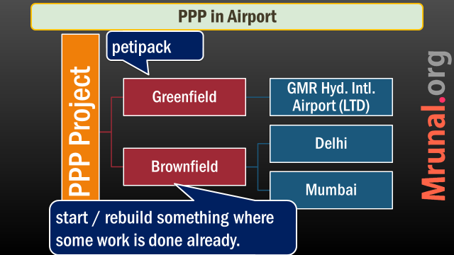
Then what is PPP?
Private player given right (“Concession”)
To provide public service
For specific time period
With commercial return on investment.

Slide 6

Can we grow rich before we grow old?
2030
India will be more populous than China
2100
India to have ~90 cr. + working population
Next 20 years
1 cr. New youth workforce per year
Demographic transition to Demographic dividend
Low income
Middle income
High income
India is here
Notes:
Figure 4: India: The Youngest Economy
By 2100, India will still have a working age population of some 931 million.
Infrastructure is critical to converting India's demography into a dividend
Greater road capacity tends to lower the cost of transport services for manufacturing, improves the sector's profitability, and thus provides an incentive to raise manufacturing output.
that poor infrastructure is partly responsible for India's transition from agriculture to services, bypassing low-skilled and semi-skilled manufacturing sector. This idiosyncratic pattern of growth has made India's recent growth to be infamously termed as “jobless growth”- where output and employment shares of the Indian manufacturing sector have hardly changed in the last 30 years.
The growth experience of the Asian Tigers shows that the early-stage manufacturing sector employs low skilled people, giving them a higher share in labour income. As the manufacturing sector expands and develops, the demand for skilled workers increases. Workers, equipped with higher incomes, respond to the demand by developing skills.
thereby imposing huge costs on society. Low productivity, poor competitiveness, high costs, and the slow pace of urbanization are some of the consequences
India will be the world’s most populated country before 2030, outgrowing China.
unable to convert its demographic transition into a demographic dividend.
can India become rich before it becomes old? In other words, will India accumulate enough wealth to afford a decent quality of life for its young and its old in the decades ahead?
Current demographic trends suggest that 10-12 million youth will enter the working age group annually for the next 20 years, requiring a million new jobs a month or some 180 million new

Slide 7
Why focus on mfg. and infrastructure?
Agri
Mfg.
Services
India direct jump, because good infra. Absent for mfg. hence jobless growth
Even low skill make in India => junta gets $$, they’ll invest to acquire higher level skill-
Like in East Asian Tigers

Slide 8
Infrastructure creates jobs: how?
Direct
Indirect
Construction itself
Forward, backward
2nd order / Growth related
Increased supply, lower prices, Higher consumption
1st stage PPP
India
2nd stage
Spain, France, Canada, US
3rd Stage
UK, Aus.
Notes:
Jobs associated with construction, operation, and maintenance of infrastructure i. Direct effect:
Indirect effect: Jobs in the supply chain (backward linkage) or distribution network (forward linkage)
iii. Induced effect: Jobs created through additional rounds of effects, for example, spending by workers. For example, workers in the power generation plant and other firms supplying it spend more, which creates additional employment
Second-order or growth-related jobs effects occur throughout the economy as each constraint to growth is removed. An increase in power supply tends to lower the price and allows higher power consumption, generating more industrial production, economic growth, and hence employment.
jobs.
three stages of a PPP Maturity Model, with countries like Spain, France, Canada and USA considered to be at the second stage of maturity of PPPs, and Australia and UK considered to be at the third stage.17While India may still be at the first stage, it has already far exceeded many others in the level of PPP activity,
There is also a pressing need to harness the potentially large supply of global funding for infrastructure. In the developed world, populations are aging, with more savings than ever before in the form of pension, insurance and other institutional funds that are looking for stable, long-term returns that infrastructure investments in India could ideally offer. If India can improve the performance of its PPP markets and attract longterm debt and fixed income products, it can easily take advantage of this sweet spot

Slide 9
PPP New bodies: red= Kelkar
3P India (Budget 2014)
Best practices, model concessional agreements
Infrastructure PPP Project Review Committee (“IPRC”)
“Actionable Stress” arising from macro-economic conditions
Infrastructure PPP Adjudication Tribunal (“IPAT”)
Under retd. SC judge/ CJH and technical/fin. experts
Engineer with 15 years xp. Law, finance etc members as well.
No gold plating by private sector. (overestimating costs)
flexibility for exchange rate, fuel supply etc.
+ Arbitration & Conciliation Act. 1996.
Notes:
Most countries which have mature PPP ecosystems (UK, Australia for example), have agencies that support PPP project implementation. Developing nations such as Indonesia and Pakistan
Finance Minister in the Union Budget 2014-15 speech had proposed setting up an institution to provide support to mainstreaming of PPPs, the 3P-India ('3P-I').
because the authority lacks funds for standard public delivery or sees the central VGF scheme as an additional grant that can be accessed without assessing whether the project is viable as a PPP
practitioner's guide and guidelines on the website () may be actively accessed by the authorities.
may be constituted to evaluate and send its recommendations in a time-bound manner upon a reference being made of “Actionable Stress” in any Infrastructure Project developed in PPP mode beyond a notified threshold value.
- An Infrastructure PPP Adjudication Tribunal (“IPAT”) chaired by a Judicial Member (former Judge SC/Chief Justice HC) with a Technical and/or a Financial member, where benches will be constituted by the Chairperson as per needs of the matter in question
An Infrastructure PPP Adjudication Tribunal (“IPAT”) chaired by a Judicial Member (former SC Judge or HC Chief Justice) with a technical and financial member, where the benches are constituted by the chairperson as needed for the matter in question.
It is advisable that a statute is enacted under Article 323B of the Constitution of India and should provide for constitution of a two-tier mechanism comprising the IPRC and the IPAT as follows:
The IPRC and IPAT shall be empowered and obliged to determine whether there is such change in the economic foundation or economic viability of a project which requires any intervention
not meant to substitute or overtake the existing contractual and regulatory mechanism to handle the lifecycle of a PPP Project, including issues of routine adjustments and escalation mechanism.

Slide 10
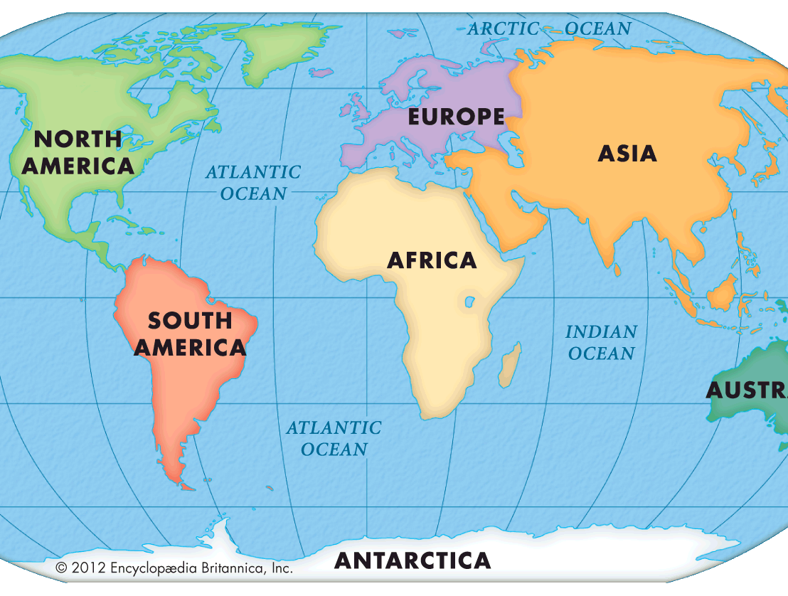
Finance problem due to twin balance sheet issue
1st world financial inclusion high
Pension-insurance fund look to 3rd world for higher return investments
4/10 project stuck
~12 lakh cr. stuck
But they’re also susceptible to
Corruption , mal governance
Scandal, Drama, uncertainty
World Bank: ~700 billion worth PPP projects in whole world
Notes:
pension funds and other institutional investors want “steady economic growth, stability and no drama” and have poor tolerance for corruption, scandal, or other forms of misgovernance, and are less likely to invest for 20 to 30 years in an infrastructure company that has cut corners.
infrastructure investment is much more sensitive to sovereign risk such
there is more saving than ever before in the form of pension, insurance and other institutional funds
India is starting on its demographic transition, most of the OECD countries are at the other end of their demographic transition as their population ages and dependency ratios rise.
institutional investors and fund managers are handling large pools of old age savings looking for relatively risk-free, stable, longterm assets to match their long-term liabilities.
World Bank's Public-Private Infrastructure Advisory Facility (PPIAF) gives a rough idea of the order of magnitudes involved under reasonable assumptions (Inderst & Stewart, 2014). The PPIAF projections result in a rough estimate of a potential US$350 to US$700 billion in
roads, where the lifecycle cost is predominantly capital cost, amortizing these costs over long durations at lower interest rates can lower tariffs,

Slide 11
PPP-Finance: Kelkar reforms
Avoid loan syndication method
1st world: 1 bank assess,
Develop
Zero coupon bond promote (L2/P1)
Company doesn’t have to pay interest till project is over.
Lock in period of 3-5 years, but pension/insurance-walla don’t mind.
Corporate bond market (BES165/P6)
Divest equity from successful PPP- use the money to create new infra.
Taxation, loan, subsidy periodic review with RBI and Government.
Then group of banks give loan. Avoid this in India.
Notes:
loan syndication methodology followed in the developed markets could be considered by lenders wherein a bank does the appraisal and then invites other lenders to join on terms and conditions
The Committee is of the opinion that stakeholders, when undertaking project structuring and financial assessment, may take cognizance of such taxation impacts, and financial proposals be quoted accordingly. However, in order to make projects more attractive, and thereby promote better private participation, the Ministry of Finance, in consultation with the Reserve Bank of India, may review applicable taxes and duties, and propose relaxations as appropriate.
Separate rating system for infra. Projects- to prevent overleveraging.

Slide 12
Finance
Find correct statement
A zero coupon bond, unlike a regular bond, pays no periodic interest to the holder.
In practice Zero coupon bond is issued at a deep discount to its face value. On maturity, investor receives face value.
A ZCB is considered as a high-risk security because its repayment is deferred until maturity.
All of above.
Notes:
Since no periodic interest has to be paid on a ZCB, the cash flow characteristics of a greenfield project match well with the cash outflows of a ZCB. Once the project is completed, the project company can raise new debt at a lower cost and retire the ZCB.
An insurance company or a pension fund has long-term liabilities. The availability of long-term ZCBs enables them to lockin a fixed yield for the entire maturity of their investment.
Accordingly, the Committee therefore recommends that the concept of “Minimum Guaranteed Cargo” may be replaced by “Minimum Guaranteed Revenue”.

Slide 13
PPP-Auditing
Problem
Art. 12 (“the State”), Demand for “Statutory Audit” of books, application of RTI
Kelkar Solution
SPV=> audit under Companies Act
Encourage corporate governance, performance audit.
Notes:
Disallow statutory audit to books of SPVs governed by the provisions of the Companies Act. Ensure adoption of principles of good governance by the SPVs
RAW
developer books of account being subjected to government audit and for access under RTI and Article 12 of Constitution.
recommends that the government notify comprehensive guidelines on the applicability and scope of such activities.

Slide 14

KELKAR: Avoid these things
No Swiss Challenge (REF: ML5/P2)
avoid them, because information asymmetries and lack of transparency.
Witch hunting of bureaucrates
amend the Prevention of Corruption Act, 1988 which does not distinguish between genuine errors in decision-making vs. corrupt practice.
“Obsolescing Bargain”
The loss of bargaining power over time by private player in PPPs
viability gap funds where user charges cannot guarantee a robust revenue stream

Slide 15
KELKAR: Avoid these things
No PPP for small projects
Because transaction cost, advisory cost very high.
No PSU in PPP
Prohibit PSUs from bidding in PPP, because they work within Government framework- Purpose of PPP is mobilize private finance and private efficiency.
But @same time, not sole profit motive, focus on service delivery also.
PPP= not panacea
PPPs should not be used as the first delivery mechanism without checking its suitability for a particular project
Some states use it to get easy fix through VGF
Notes:
IEC-FAQ: www.pppinindia.com; www.infrastructureindia.gov.in; www.pppinindia.com

Slide 16
Kelkar
Which of the following PPP-reforms are suggested by Kelkar Committee?
Compulsory CAG audit for all PPP projects
Debt waiver scheme for highway contractors
Give first preference to PSU –entities in bidding
None of above.

Slide 17
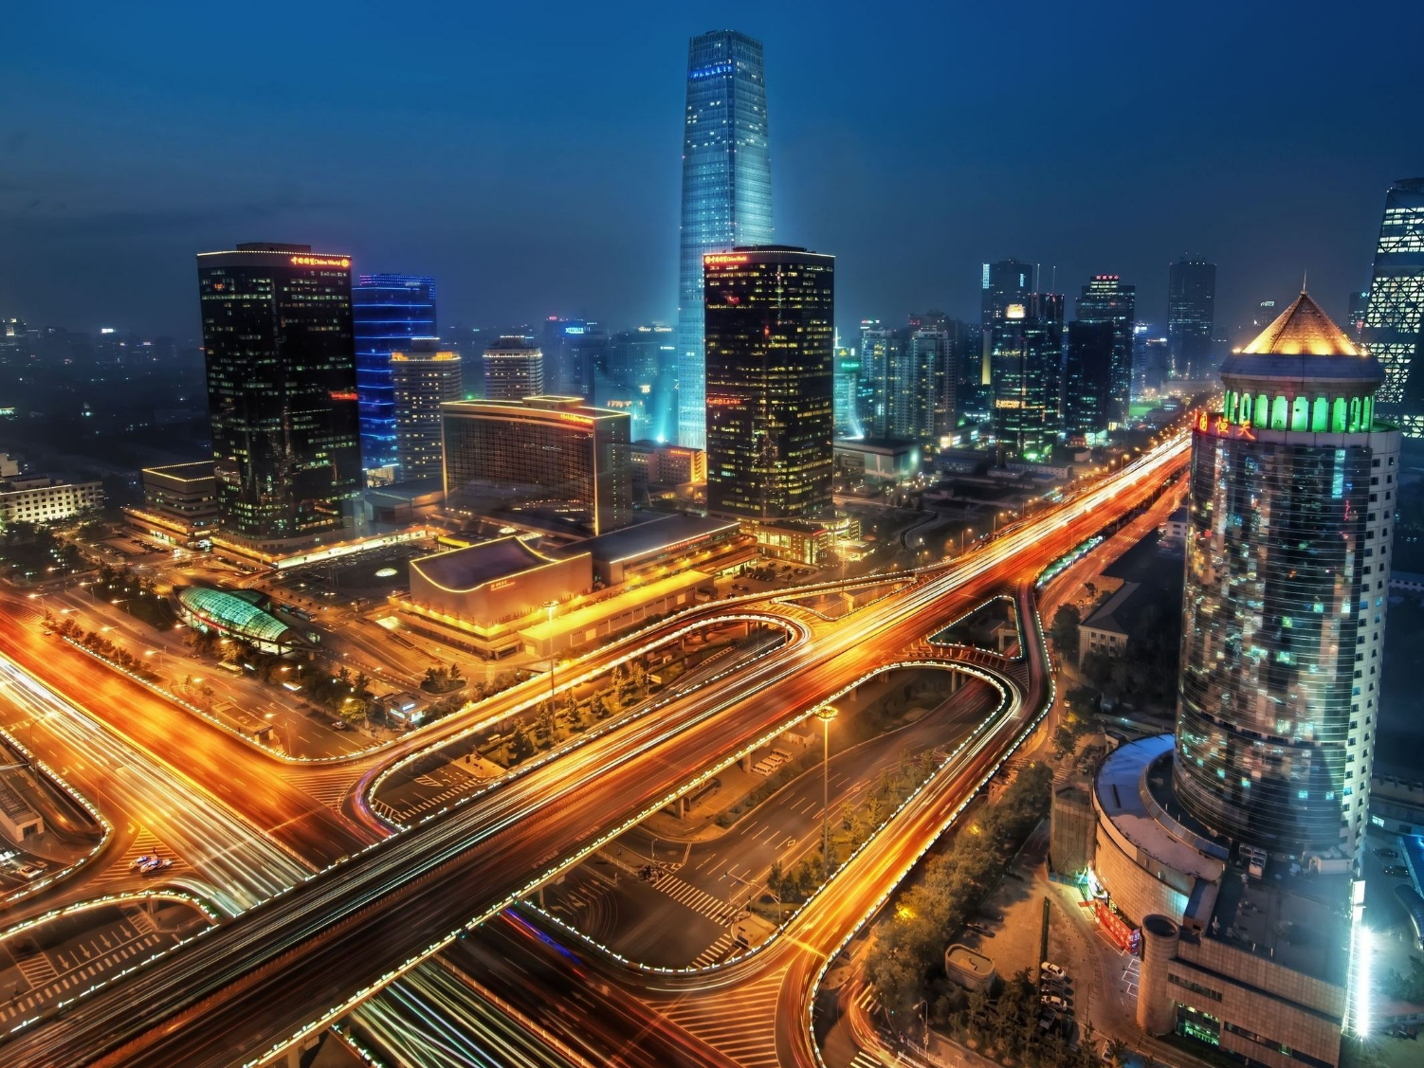
BES165 Infrastructure=> Transport & Real Estate
Kelkar PPP
Rail Budget
CAP-2016
Road/Ship
Urban infra.

Slide 18
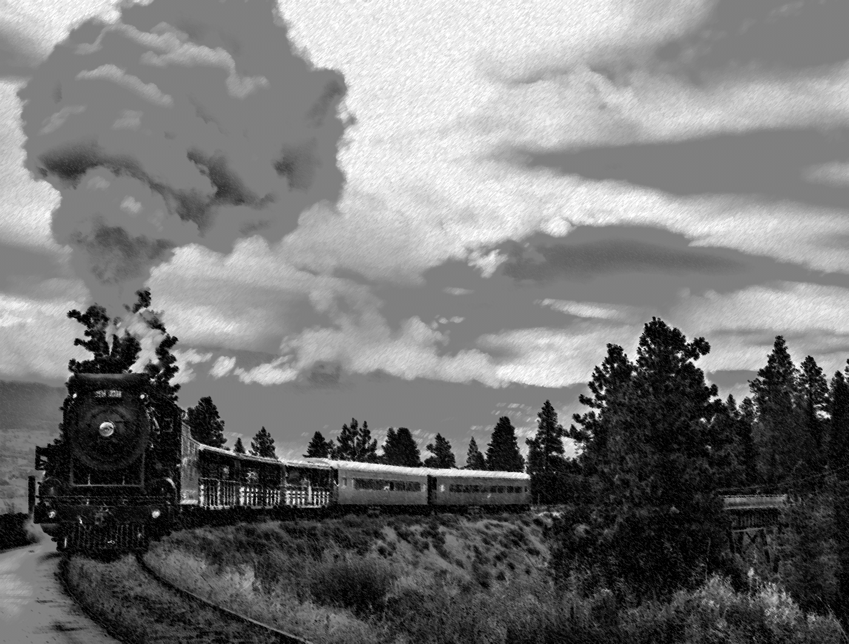
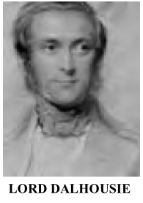
Reasons 1) Commercial 2) administrative 3) defense
Railway Minutes & “Guarantee system”: 5% interest on investment, Government to buy after contract
THANE
1853
Bombay to Thane
1854
Madras to Arakkonam
Calcutta to Raniganj
1856
1853: 21 Miles
Chief Engineer George Clerk
Bombay

Slide 19
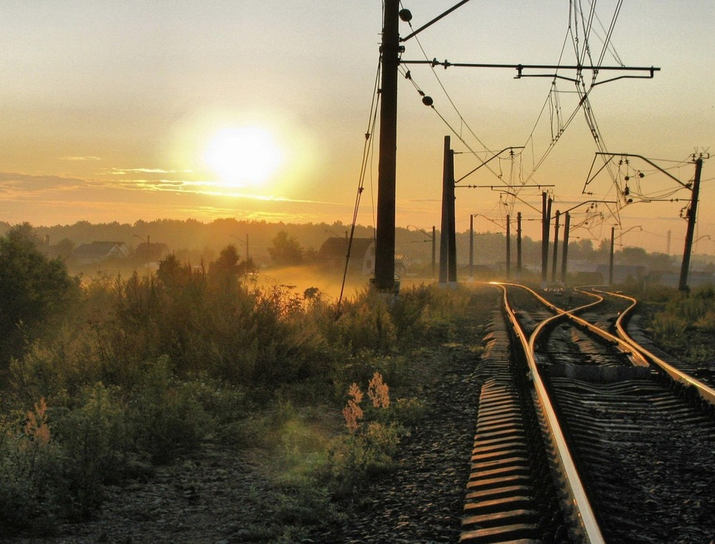
Rail Track: type of Gauge
Broad (British)
1,676 mm (5 ft3″)
Meter
1,000 mm (~3ft3″)
Narrow (Hill areas)
762 mm; 610mm (lift gauge)
Rail track wise, decreasing order
Project Uni-gauge
Convert these to Broad, in selected routes

Slide 20
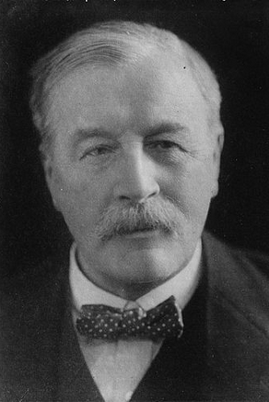
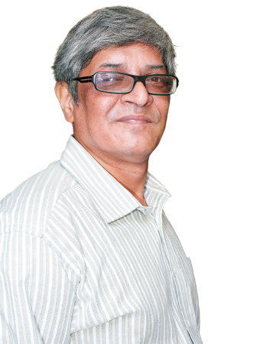
Acworth Committee 1921
Rail budget
1924-25: Separate rail from gen. budget
Constitution permits mentions/permits….x
parliament rules permit…yes
बंध करो ये नाटकबाजी
- Bibek Debroy, Member Niti Ayog, Report to gov. Jun’16

Slide 21
NITI: Why Merge Rail Budget with Gen. Budget?
unsolved
Underinvestment; under-achievement of targets
Rail is not as big as 1924
Defense budget >> Rail budget
Government ⇧ yes; governance ⇧ nope
Natak-baazi
Publicity stunt to announce populist measure
Doesn’t have $$ to fulfill promises
Merging will not ⇩ outlay. Rail will continue to receive the priority

Slide 22
RAIL Budget 2016
Nav Arjan
New revenues
Nav Manak
New norms
Nav Sanrachna
New Structures.

Slide 23
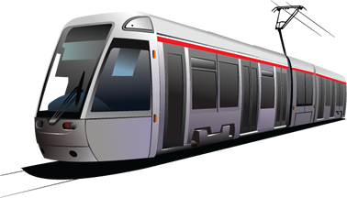

High speed and Bullet trains
भारतने अपनी औकात से ऊँचे सपने देखे तो “हमको मजा नही आएगा”

Slide 24

Highspeed Rail (200-250 kmph)| Bullet (320kmph)
Anti
Noise pollution, Environmental degradation
Dislocation of people
Regionally imbalanced development.
Pro
successful in Japan, China and Europe
more comfort, less journey time
Agglomoration benefits of joining labour with urban market
Construction itself =employment
हमें भूखे नंगे रहेके अपनी गरीबी का दुखड़ा रोना चाहिए.
Notes:
Bullet train: 320kmph, high speed: 200-250kmph. But marginal increase in speeed= far more $$ needed for special tracks and trains = higher price = unviable, people will go for airfare. Hence sweet spot = ~200kmphs

Slide 25

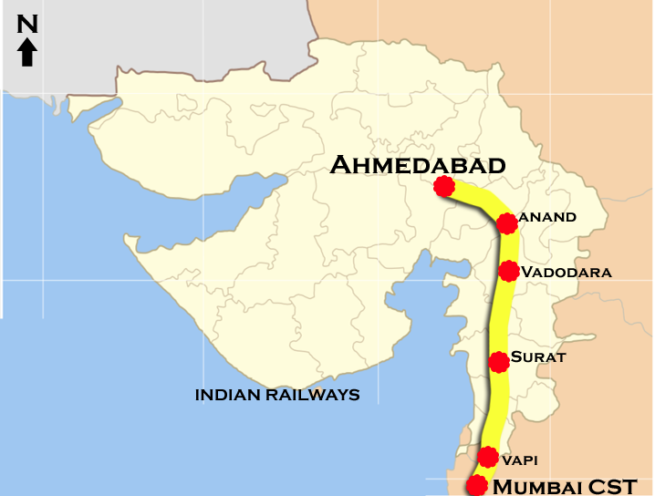

~1 Lakh crore: Jap to loan 80%
Repay from 15th yr. of ops- till 50th year.
Certain % material/tech. must be jap.
Rs.1500 per ticket
Then have to make 100 trips per day to make enough $$ to repay (IIM-A)
Counter: tech. percolation of cutting edge infrastructure, national pride, economic dev., “Project export”
Notes:
Bullet train between A'bad to Mumbai.
Japan to fund ~80% of project (need ~1 lakh crore.) India will have to begin
Assume Rs.1500 charge for 300 km drive x 15 years- then it'll have to make 100 trips per day with total ~1 lakh passengers to make enough $$ to repay.
Counter:
508 kms; 750-1200 seats; 35 trips per day
105 trips by 2053

Slide 26
Rail Budget-2016: New Trains
unreserved passengers
Antyodaya Express unreserved, superfast service.
Deen Dayalu coaches: unreserved coaches with potable water and higher number of mobile charging points.
Reserved Passengers
Humsafar - fully third AC with optional meal
Tejas - 130 kmph and above with wifi, food, entertainment
UDAY - overnight double-decker, Utkrisht Double-Decker Air-conditioned Yatri Express on the busiest routes

Slide 27


UPSC CAPF 2016
Find correctly matched pairs
Antyodaya Express: Reserved
Deen Dayalu: Unreserved
Humsafar: Reserved
Tejas: Unreserved
Correct matches
A) 1, 2 and 3 B) 2 and 3
C) 3 and 4 D) only 2

Slide 28

Wildlife journey (Madhya Pradesh)
Tour Package
Bandhavgarh: Son river
Panna: Ken river
Pench: Totlah Dam
=====
Astha circuit for pilgrim centres.

Slide 29
Finance and accountability
Finance
300 Cr. /> : EPC contract only
PPP for new freight corridors
toilets advertisement rights, CSR, NGO
Accountability
Station Directors with cross functional teams; to make one person accountable for all facilities on trains
dedicated IVRS system, Mobile app, e- Tender, Operational audits
Geo Spatial satellite tech. to review physical progress
BoT
Min. 80% revenue guaranteed @Bidding stage
No share to Railways till 120%
Afterwards- addl. Revenue to be shared with Railways.

Slide 30

Rail budget
criticism
To much emphasis on PPP model
But most of EPC contractor cos. Of Railways have taken too much debt.
Will aggravate NPA/ will not kick off.

Slide 31
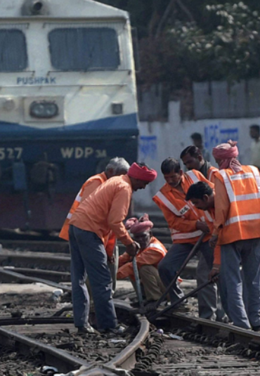
Worker / Safety
Rail budget
Rakshak device, walki-talkie: to alert gang men about approaching trains,
Coolie: henceforth “Sahayak”, new uniform, soft-skills.
loco pilots: AC and toilet
By 2020, no unmanned crosses.
Notes:
Gangmen, now redesignated as track maintainers, are most vulnerable to getting run over by trains while performing their duty round-the-clock. About 400 gangmen are killed every year in train accidents while on duty.
weight of the tools carried by them while patrolling.

Slide 32
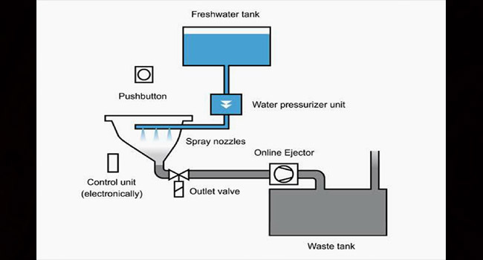
Bio-vaccum toilets in railways
10-15 lit. water per flush, DRDO
~500 ml water per flush, Aircraft
Output
Gas + water
Anaerobic
Psy-chro-phile bacteria
Notes:
Earlier used in aircrafts, now in trains

Slide 33

Environment
Rail budget
LED bulbs
Rain Water Harvesting facility
Water recycling plants.
Energy audits
composite sleepers made of recycled plastic waste
zero direct discharge of human waste.

Slide 34
Rail budget 2016
Women/S.citizen
Janani sewa: children’s menu items on trains, baby foods, hot milk and hot water
Increased quota in seats.; Concessional rates for S.citizen; middle bays reserved in coaches for women.
Divyang/PH
Rail Mitra Sewa: battery operated cars, porter services, etc. on a paid basis
PH-friendly toilets; Wheelchairs: pick and drop; Braille enabled coaches
ICT/E-gov
Only 2 Mobile Apps (1) ticket (2) complaint/suggestions
‘Clean my Coach’ through SMS; Automatic ;ticket vending; OPT for one time registration ; Smart cards, cashless purchase.
Wi-Fi provided in 100 stations, to be provided in 400 more.
Security through helplines & CCTVs; Track Management System (TMS)
Health
exchange between Railways hospitals and Government hospitals
introduce ‘AYUSH’ systems in 5 Railway hospitals;
Skill Development
Internship to 100 Engineers/MBA; Rail university @Vadodara

Slide 35
Freight
Freight App- Parichaalan (Survey)
TRANSLOC- logistics company to develop warehouses in PPP mode.
Cold storage facilities, 1st preference to farmers/fisherman
Rail auto hub @Chennai
Coach related
SMART (Specially Modified Aesthetic Refreshing Travel) Coaches- ergonomic design, entertainment displays etc.
Mahamana express: Delhi to Varansi, with refurbished coaches
Misc.
Vikalp: Train accommodation scheme for waitlisted passengers.
Travel Insurance for passengers
FM Radio, Rail Bandhu magazine in regional languages

Slide 36
Railways: R&D => New structures
SRESTHA.
Special Railway Establishment for Strategic Technology & Holistic Advancement,
For Long term research
Sutra
Special Unit for Transportation Research and Analytics (SUTRA)
cross functional teams for investment/ops. Decisions
Misc.
Mission Raftaar for higher speeds, Mission Hundred for commissioning 100 sidings/ freight terminals, Mission beyond book-keeping for accounting reforms, Mission Capacity Utilisation to prepare a blueprint DFC and so on

Slide 37
Railways: R&D, skill Development
C T Venugopal chair
Strategic Finance, research and policy development
He was 1st Indian Railway account service officer (1930)
Kalpana Chawla chair
on geo-spatial technology.
Indo American Astronaut. Died in space shuttle "Columbia" (2003)

Slide 38
BES165 Infrastructure=> Transport & Real Estate
Kelkar PPP
Rail Budget
CAP-2016
Road/Ship
Urban infra.

Slide 39
Civil Aviation Ministry (Yearbook)
DGCA: air traffic, licensing
Bureau of civil aviation security
Commission of Railway safety
Pawan Hans, offshore oil, hill areas
Air India -> Hotel corp. ltd.
AAI airport: 125 airports

Slide 40
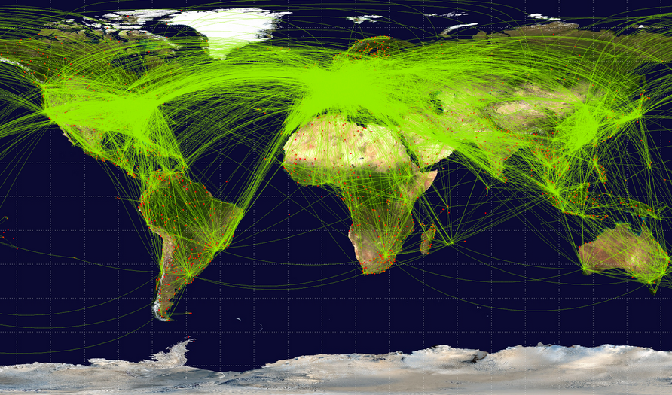
Aviation sector: India ranked 10th (# of passengers)
Ideal location between east and west hemisphere
Maintenance, Repair and Overhaul (MRO): 5kcr biz. but 90% goes to Sri Lanka, Singapore, Malaysia, UAE etc. for technology, skill. Budget-2016: tax tweaking
Notes:
Custom duty on repair spareparts.

Slide 41
Civil Aviation Policy 2016: Regional connectivity
Union
Max. service tax 10%
VGF: 80:20 / 90:10 – through regional connectivity fund via levy on air passengers
State have to
Max. 1% VAT on ATF
Water, sewage etc. @concessional rates
If 1 middle class Indian family 1 air trip per year => yearly 30 cr ticket sales
Notes:
ment multiplier are 3.25 and 6.10 respectively.
if every Indian in middle class income bracket takes just one flight in a year, it would result in a sale of 35 crore tickets,
This will be possible if the air-fares, especially on the regional routes, are brought down
enable 30 crore domestic ticketing by 2022 and 50 crore by 2027, and international ticketing to increase to 20 crore by 2027. Similarly, cargo volumes should increase to 10 million tonnes by 2027.
promote tourism, increase employment and lead to a balanced regional growth.
RCS will be made operational only in those States which reduce VAT on Aviation Turbine Fuel (ATF) at these airports to 1% or less for a period of 10 years.
No-Frills Airports will be done at an indicative cost of Rs 50 crore to Rs 100 crore, without insisting on its financial viability.
Service tax on tickets will be levied on 10% of the taxable
police and fire services free of cost. Power, water and other utilities will be provided at substantially concessional rates.
VGF will be shared between MoCA and the State Government in the ratio of 80:20. For the North Eastern States, the ratio will be 90:10.
payment of the full amount of VGF will be made to the airline operator from the Regional Connectivity Fund (RCF)

Slide 42
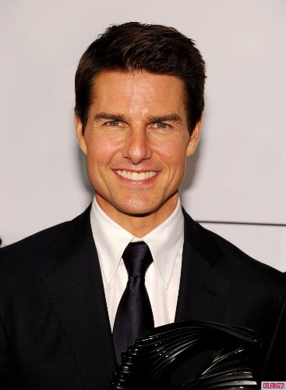
5/20 rule
Aviation Policy 2016
Started in 2004
can run intl. flight onlyIF min.
20 aircrafts
5 years domestic xp.
NEW: 5 years exp eliminated, technical tweaking.
Notes:
RDG was introduced in 1994 to provide air connectivity to Jammu and Kashmir, North East Region, Andaman& Nicobar Islands, Lakshadweep, Tier-2 and Tier-3 cities, by way of internal cross-subsidy

Slide 43

Aviation Policy 2016
skilling
Commercial pilot license: ~30 lakh fees.
Still, Lack of regular employment: Tweaking labour contract acts
Subsidized training @public, private academies, 3.3 lakh jobs by 2025
security
DGCA more powers to inspect & fine
Private security agency can be used- must register under PASARA Act 2005, CISF will train them by charging fees.
Misc.
Max. airfare per hr : Rs.2500/-
Route Dispersal Guidelines (RDG) of ‘94 tweaked = more air connectivity to J&K, hill states, island UT. Union to give subsidy to airlines.
Chicago Convention 1944: bilateral rights, open skies
Climate change, energy audit.
@costal areas Seaplane tourism, air-sport

Slide 44
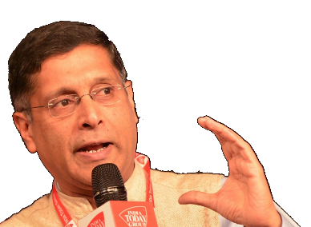
Why/How promote domestic tourism?
Global slowdown = fall in intl. tourist
Desi tourists like pilgrim/religious sites
Mudra loans to Tourism related MSME

Slide 45
Tourism: Direct/indirect jobs + Forex
Swadesh-Darshan
Theme-based tourist circuits in a way that caters to both mass and niche tourism
PRASAD HRIDAY (L7/P8)
National Mission on Pilgrimage Rejuvenation and Spiritual Augmentation Drive (PRASAD)
India Healthcare portal
To promote medical tourism
List of registered hospitals and wellness centres
+ summits held in Delhi to showcase India
E-Tourist visa
HRIDAY: National Heritage City Development and Augmentation Yojana
with 113 nations (MHA)
streamlined frees on reciprocal basis: 0, 25, 48, 60 dollars
Longer duration e-visa, More E-Visa counters, biometric facility,
Haats in cities to portray miniature culture

Slide 46
BES165 Infrastructure=> Transport & Real Estate
Kelkar PPP
Rail Budget
CAP-2016
Road/Ship
Urban infra.

Slide 47
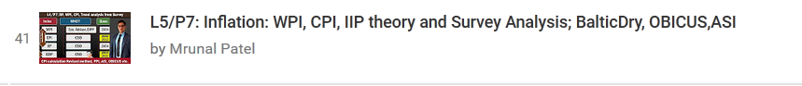
Ports: theory- major vs minor click me
Budge 2014: Ports will be corporatized, but now Nitin Gadkari says Ports will not be corporatized
1st Maritime India summit @Mumbai, Modi says 1 lakh cr. To be invested for port development.

Slide 48
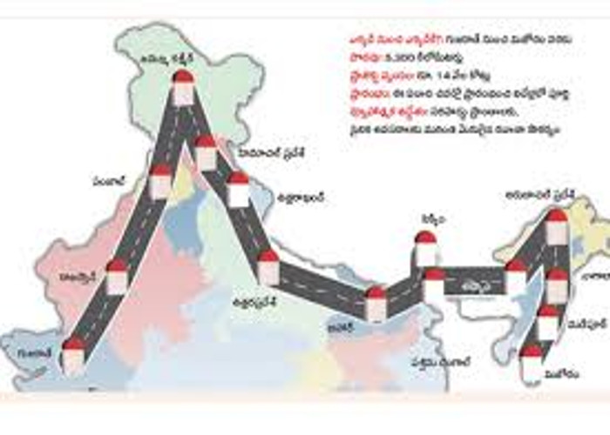
Bharat Mala: 80k crores, 7k km-road (build-upgrade); by 2019
Benefits
1.Strategic: move army, logistics, disaster mgmt in neighbor nations
2.economic: raw material, finished goods
Connect West (Gujarat)
To East
(Mizoram
Entire land border covered in this “necklace” / Mala
Connect with Coastal area (Maharashtra)
Connect with Coastal area (Bengal)
Sagar Mala for Port Infrastructure self study
Notes:
As per august data http://pib.nic.in/newsite/printrelease.aspx?relid=124217

Slide 49
Bharat Mala Construction
Road ministry
Border areas / tougher terrains
Ordinary areas
Bidders
Defense Min.
BRO
NHAI

Slide 50
BES165 Infrastructure=> Transport & Real Estate
Kelkar PPP
Rail Budget
CAP-2016
Road/Ship
Urban infra.

Slide 51
Real estate
problems
Builders took too much debt=> houses not sold but prices not coming down (NHB-RESIDEX)
Relaxed FDI policy
RBI tweaked loan-to-value ratio has been increased to 90 per cent for loans up to Rs. 30 lakh.
Housing for all by 2022| Smart cities/ ReITs Ref: L7 and ML1 series
Bills: 1) model building bye laws 2) Real estate regulation
Positive : forward backward jobs
Notes:
Backward linkage= demand in input sector = job creation.
Forward linkage= demand in furniture, painting etc. = job creation
unsold housing units, weak demand yet prices not declining in most cases- due to heavy flow of capital by debt instrument.
National Housing Bank’s RESIDEX (index of residential prices).
40 different kinds of approvals and No Objection Certificates (NoC) are required for a building project.
25% projects delayed by this for 2-3 years.
take anywhere between two and three years for construction to start.

Slide 52
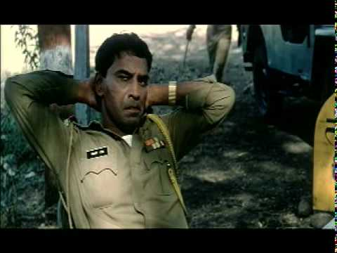

Model building byelaws
Building regulation: State subject
Model Building Byelaws by Ministry of Urban Development for adoption in the entire country
40 different NOC=>25% projects delayed by 2-3 years
India ranked 183rd out of 189 economies in procedural delay (World Bank Ease of Doing Biz)
Apply Online: pass within 30 days. Minimal human interface, min. corruption
ULBs can give environment clearance, no separate application

Slide 53
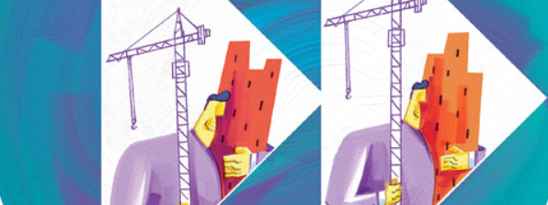
3 Cat. Buildup area (Sqm)
Rain water harvesting, roof top solar plants
fire safety, structural safety, earthquake and natural disaster safety
PH, elderly, children friendly
Smaller area= less requirements, faster clearance
5,000 to 20,000
20,000 to 50,000
50,000 to 1,50,000.
Notes:
a risk-based matrix for different types of buildings has been introduced so that small buildings with low- risk criteria get faster approvals whereas the high-risk buildings such as malls, multi-storied and big complexes are examined in detail.
Provisions for the elderly, physically challenged and children have also found place in the Model Building Byelaws.
he

Slide 54
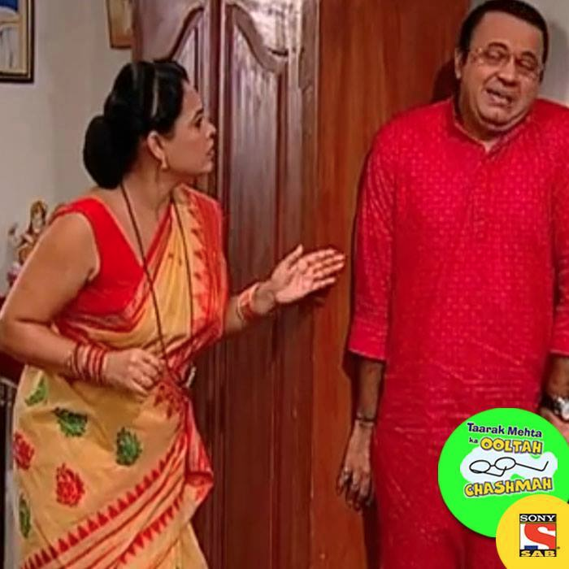
Real estate: Legal protection (Chronological)
1986
2002
CCI: unfair trade practices
Consumer protection act
2013
Model Real Estate reg. & development bill by HUPA
2016, Mar
Passed in both houses

Slide 55
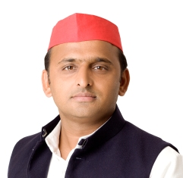
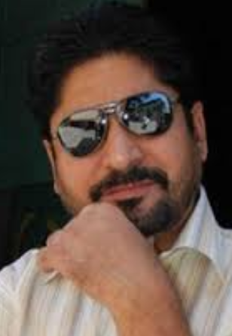
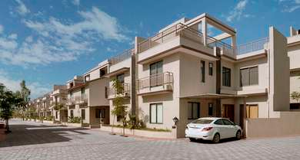
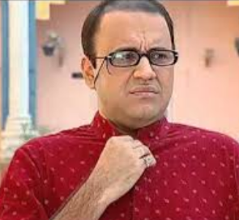
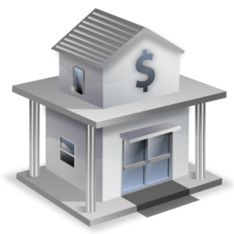
Union=> Central Advisory council
RE Appellate Tribunal (for one / more states)
Chairman + 1 Technical member + 1 judicial member
Real Estate Regulatory Authority (RERA)
Chairman + min. 2 members:
Members xp real estate, law, commerce, urban Development
Function : Regulate buyer, seller, agents; advice state Govt
Register, only then booking
If RERA takes no action for 15 days => automatic registration
Can’t take >10% advance w/o written agreement
70% amt in separate bank account; use only for construction (States free to change ratio)
Notes:
The Bill mandates that 70% of the
amount collected from buyers of a
project be used only for construction
of that project. In certain cases,
the cost of construction could be le
ss than 70% and the cost of land
more than 30% of the total amount co
llected. This implies that part of
the funds collected could remain
unutilized, necessitating some
financing from other sources. This could raise the project cost
But State Government can alter.

Slide 56
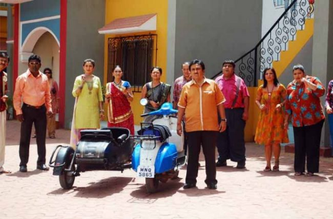
Responsibilities of promoter & buyer
Buyers
Form cooperative society / association
Seller/ Promoter/Builder
Essential services till “society” takes over
Can’t finish in deadline=> return $$ with interest
More: http://www.prsindia.org/billtrack/the-real-estate-regulation-and-development-billi-2013-2861/

Slide 57
Can Parliament make laws on real estate?
State
Land
Land improvement
Concurrent
Contract,
Transfer of property
Land colonization
CRITICISM
Bill confined to ‘contract’ part; but black money, title clearance etc. still under states’ laws.

Slide 58
BES165: Infrastructure
Nuke Energy NSG, HELP-2016
Postal, Telecom, Mass.Comm (YB)
Kelkar-PPP
Rail Budget CAP-2016
Urban Infra-Bills.
Paris Summit Clean Energy

Slide 59
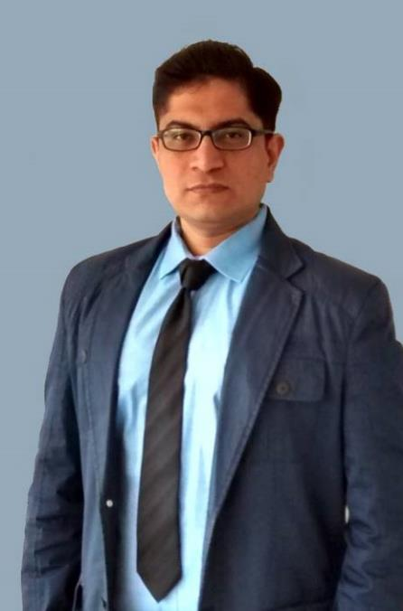
Theory +Economic Survey Vol.2 + Vol.1 + Budget 2016
1.Banking Finance
6.HRD
2.Budget-Fiscal Policy
3.BoP
4.Sectors of Economy
5.Infra & environment
V2C2-Pub.Fin; V1C3-JAM
V2C3-Monetary mgmt+FI
V2C4-External sector
V2C5-Price,Agri.; V2C6,7
V2C8-Paris Summit, Energy
V2C9-Social infra.
V1C4-Agri ; V1C9-Fertilizer
V1C5-mother-child
V1C6-bounties; V1C7-Fiscal Cap
V1C8-PTA
V1C2-Chakravy; V1C10-Labour
V1C11-Powering 1 India
B1. Financial Sector Reforms
B2. Fiscal Discipline
B3. Tax Reforms; B4. Ease of
B5. Agro: 2x farmer income
B6. Rural infra-employment
B7. Infrastructure
B8. Social Sector & healthcare
B9. Education, Skills, Jobs
V2C1- Chakravyuh challenge
V1C1- Twin Balancesheet
IYB:7-Commerce

Slide 60
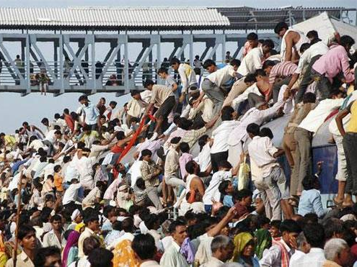
Next time BES166► Human Resource development
Census Theory
Education New Policy 2016
Health & Welfare Women, Children
HDR’15 | SDG’16-30

